Slide 1


Credit card Fraud Detection
Machine Learning
Team 3: Anthony Banks, Sacide Belair, Pamala Cox, Love Lorissaint
September 18, 2024

Slide 2
Have You ever been a victim of credit card fraud?

Slide 3

Did you know?
60% of U.S. credit card holders have been victimized by fraud, and 45% have experienced fraud multiple times.
52 million Americans had fraudulent charges on their credit or debit cards last year, with unauthorized purchases exceeding $5 billion.
The median fraudulent charge also jumped 26% in the last two years, rising from $79 to $100.
Only 7% of fraudulent charges involved stolen or lost credit cards; the rest accessed personal data and account information remotely.
Security.org

Slide 4
Introduction
Problem Statement
Credit card fraud costs financial institutions billions each year. Detecting fraud in real-time is challenging due to the rarity of fraudulent transactions compared to legitimate ones.
Goal: The goal of this project is to build a machine learning model using the Kaggle Credit Card Fraud Dataset to predict fraudulent transactions accurately and minimize false positives.
Key Focus: Our approach centers on addressing class imbalance and tuning the threshold to balance precision and recall.
Dataset: The dataset contains anonymized transaction data with both fraud (1) and non-fraud (0) labels, specifically the western united states.
Dataset Source: Kaggle Credit Card Fraud Data by Neha Roychoudhury

Slide 5
Objectives
Build a machine learning model to detect fraudulent transactions.
Handle the class imbalance between fraudulent and non-fraudulent transactions.
Evaluate model performance using precision, recall, F1-score, and AUC-ROC metrics.
Provide insights into key features that contribute to fraud detection.
Use threshold tuning to enhance the model's ability to detect fraud with minimal false positives.

Slide 6

Data Exploration & Preprocessing
Dataset Overview:
the dataset contains approximately 150,000 transactions and 18 columns, including features like amount, merchant, category, state, city and transaction time.
Data Cleansing:
No missing values. The Amount feature was normalized to account for high variability in transaction amounts.
Class Imbalance:
Fraudulent transactions represent a small portion of the dataset (~0.38%).
We addressed this by using class weights in the Random Forest model and applying Random Under-sampling to balance the fraud and non-fraud cases for effective learning.
Notes:
The dataset contains approximately 150,000 transactions and 18 columns, including features like Amount, Merchant, Category, State, City, and Transaction Time.

Slide 7

Feature Engineering
Key Features:
We used features such as Amount, Merchant, Category, State, City, and Transaction Date.
The Amount feature was normalized to account for variability across transactions.
Feature Importance:
Using the Random Forest model, we identified that features such as Amount, City Population, and Merchant are critical for predicting fraudulent transactions.
Visualization:
Feature Importance Bar Chart: This chart shows the top contributing features used by the model to predict fraud.
Notes:
Pam is next

Slide 8

Model Selection
Models Considered:
Logistic Regression: Used as a simple baseline model.
Random Forest Classifier: For its ability to handle class imbalance and provide insights into feature importance.
XGBoost: Contemplated use for comparison based on research on best models to use, but not selected as the final model as it was not covered in curriculum.
Training and Testing: The dataset was split into 80% training and 20% testing sets, with cross-validation applied to avoid overfitting.
Final Model: Random Forest with class balancing and threshold tuning was selected as the final model for this project.

Slide 9
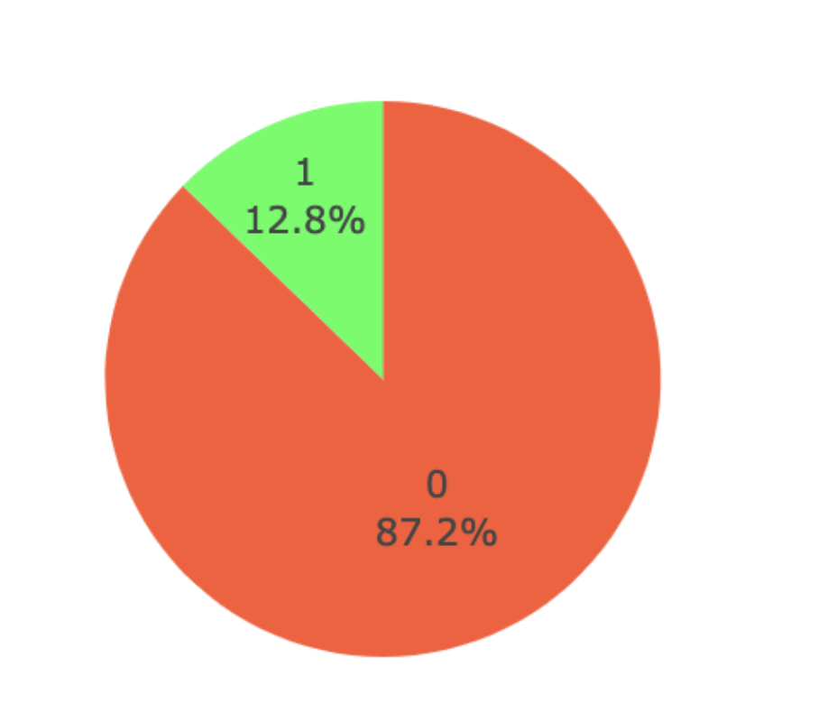
Handling Class Imbalance
Approach:
We applied Random Under-sampling to ensure a balanced representation of fraud and non-fraud cases in the training set.
Additionally, we used class_weight='balanced' within the Random Forest model to compensate for the imbalance.
Result: This helped improve the model’s ability to detect fraudulent transactions while minimizing false positives.

Slide 10
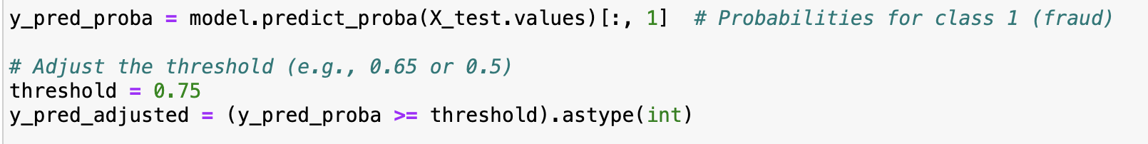
Model Performance Evaluation
Metrics:
Precision: Accuracy in predicting fraud (true positives out of all predicted positives).
Recall: Ability to capture actual fraud cases (true positives out of actual fraud cases).
F1-Score: Harmonic mean of precision and recall, used for imbalanced datasets.
Confusion Matrix:
True Negatives: Correctly predicted non-fraud transactions.
True Positives: Correctly predicted fraud cases.
False Positives: Non-fraud transactions incorrectly flagged as fraud.
False Negatives: Fraud cases missed by the model.
Threshold Tuning: Adjusted threshold to 0.75 to improve fraud detection while maintaining precision.
Notes:
Recall, also known as sensitivity or true positive rate, measures how well a model correctly identifies positive instances (in your case, fraud). It answers the question:
Of all the actual fraud cases, how many did the model correctly identify as fraud?
In fraud detection, recall is crucial because missing actual fraud cases (false negatives) could have significant consequences. You want a model with high recall to ensure you catch as many fraudulent transactions as possible.
The F1-score is a metric that combines both precision and recall into a single value to give a balanced measure of a model's performance, especially when dealing with imbalanced datasets like fraud detection.
What It Measures:
Precision: How many of the predicted fraud cases were actually fraud.
Recall: How many of the actual fraud cases were correctly identified by the model.
The F1-score is the harmonic mean of precision and recall, which means it gives a balanced evaluation of both metrics.
Threshold tuning is the process of adjusting the decision boundary that a model uses to classify instances as either positive (fraud) or negative (non-fraud). In the context of fraud detection, this threshold typically refers to the probability above which a transaction is classified as fraudulent (class 1) and below which it is classified as non-fraudulent (class 0).
By default, many classification algorithms use a threshold of 0.5, meaning that if the model predicts a probability greater than or equal to 0.5 for a class, it will classify the instance as belonging to that class. However, adjusting this threshold can affect precision, recall, accuracy, and overall performance depending on the specific objectives of the task.

Slide 11
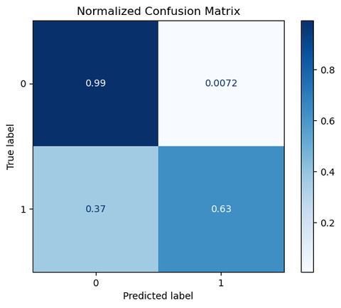
Normalized confusion matrix
Interpretation:
Row 1 (Actual Not Fraud):
99% of actual non-fraud transactions were correctly predicted as non-fraud (True Negatives).
0.72% of actual non-fraud transactions were incorrectly predicted as fraud (False Positives).
Row 2 (Actual Fraud):
63% of actual fraud transactions were correctly predicted as fraud (True Positives).
37% of actual fraud transactions were incorrectly predicted as non-fraud (False Negatives).
Key Insights:
High accuracy for non-fraud detection: The model is highly effective at predicting non-fraudulent transactions with 99% accuracy.
Moderate accuracy for fraud detection: The model detects 63% of fraudulent transactions, but 37% of fraud cases are missed (False Negatives).
This shows room for improvement in detecting fraud.

Slide 12
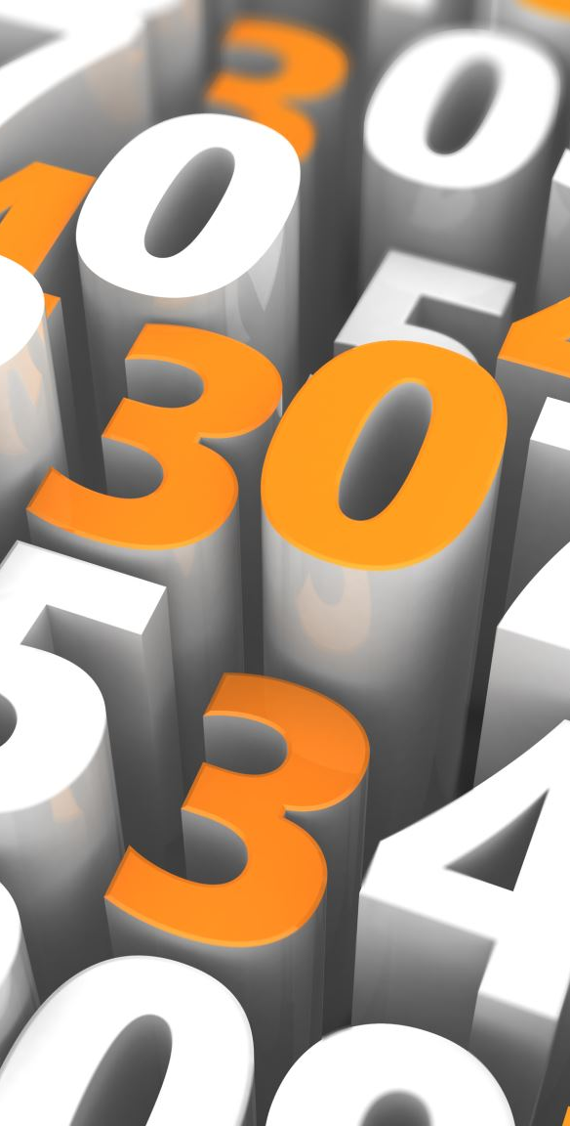
Results & Insights
Key Results:
Overall Accuracy: 95.18%.
Non-Fraudulent Transactions (Class 0):
Precision: 96%, Recall: 98%, F1-Score: 97%.
Fraudulent Transactions (Class 1):
Precision: 86%, Recall: 74%, F1-Score: 80%.
Key Insights:
Strong Non-Fraud Detection: The model accurately identifies non-fraud transactions with minimal disruption to legitimate users.
Fraud Detection: Precision is high, but recall could be improved to catch more fraudulent transactions.
Business Impact: Reducing false positives while maintaining fraud detection improves operational efficiency.

Slide 13

Challenges & Solutions
Challenge: Handling highly imbalanced data where fraud cases are a small fraction of the total transactions.
Solution: Applied Random Under-sampling and class weight balancing in the Random Forest model to ensure the model effectively learned from the fraudulent transactions.
Future Improvements: Continue fine-tuning the threshold or test additional balancing techniques like SMOTE to further improve recall without increasing false positives.

Slide 14

conclusion
Summary:
We built a Random Forest model that detects fraudulent transactions with a high degree of accuracy.
By adjusting the decision threshold, we found a balance between fraud detection and minimizing false positives.
Next Steps:
Explore other machine learning models like XGBoost and Gradient Boosting for further improvements.
Implement hyperparameter tuning to fine-tune the Random Forest model and further enhance its performance.
Notes:
Both XGBoost and Gradient Boosting are advanced tree-based algorithms that iteratively improve predictions. They can capture more complex patterns in the data than simpler models like Logistic Regression or Random Forest.
Similar to Random Forest, XGBoost and Gradient Boosting provide insights into the importance of various features in the dataset. These insights can help understand which features are critical for predicting fraud.
Exploring XGBoost and Gradient Boosting allows you to leverage more advanced techniques that can lead to more accurate predictions, better handling of imbalanced data, and deeper insights into the features driving the results. These models can help you refine your fraud detection system and improve operational efficiency.

Slide 15
Q&A
WITH VISUALIZATIONS

Slide 16
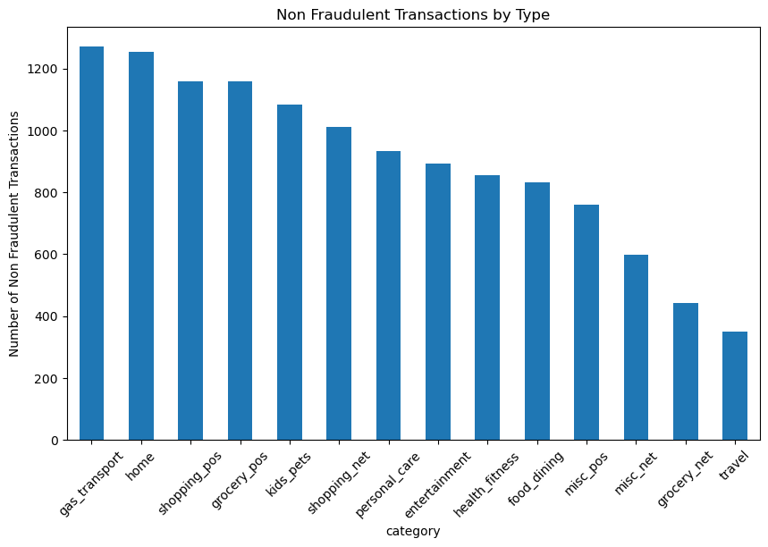

Slide 17

What are the most common types of fraudulent credit card transactions?

Slide 18
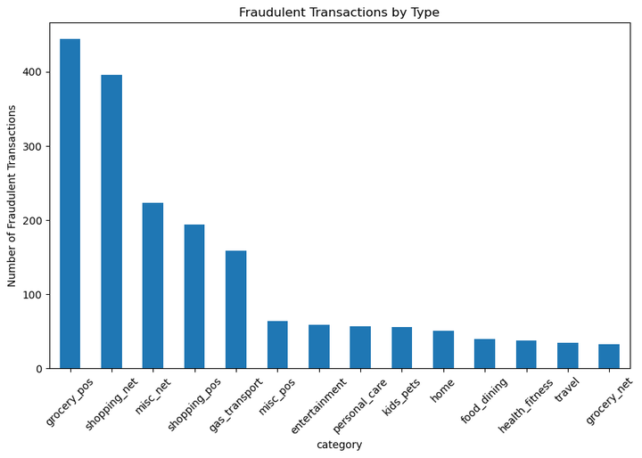

Slide 19

what is the typical fraudulent transaction range In dollars?

Slide 20
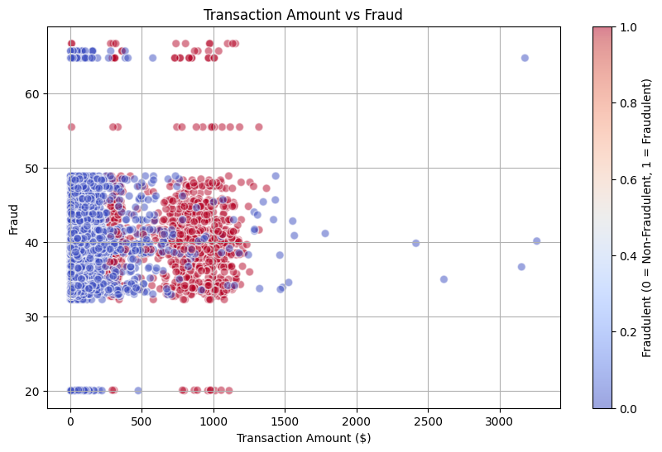

Slide 21
Can anyone guess which transaction category—like health & fitness, Personal Care, Groceries etc. —has the highest percentage of fraud?

Slide 22
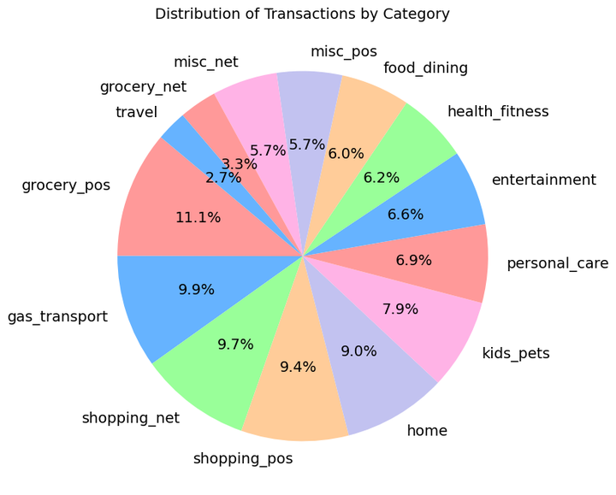

Slide 23

CAN YOU GUESS WHICH TIME OR DATE FRAUDULENT TRANSACTIONS ARE MORE LIKELY TO OCCUR?

Slide 24
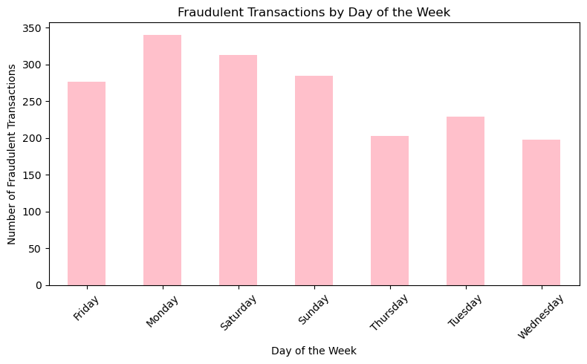

Slide 25
WHICH STATES HAVE THE MOST CREDIT CARD FRAUD?

Slide 26
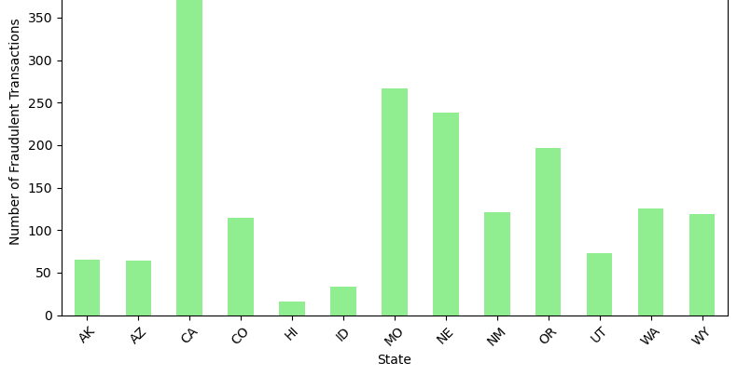

Slide 27
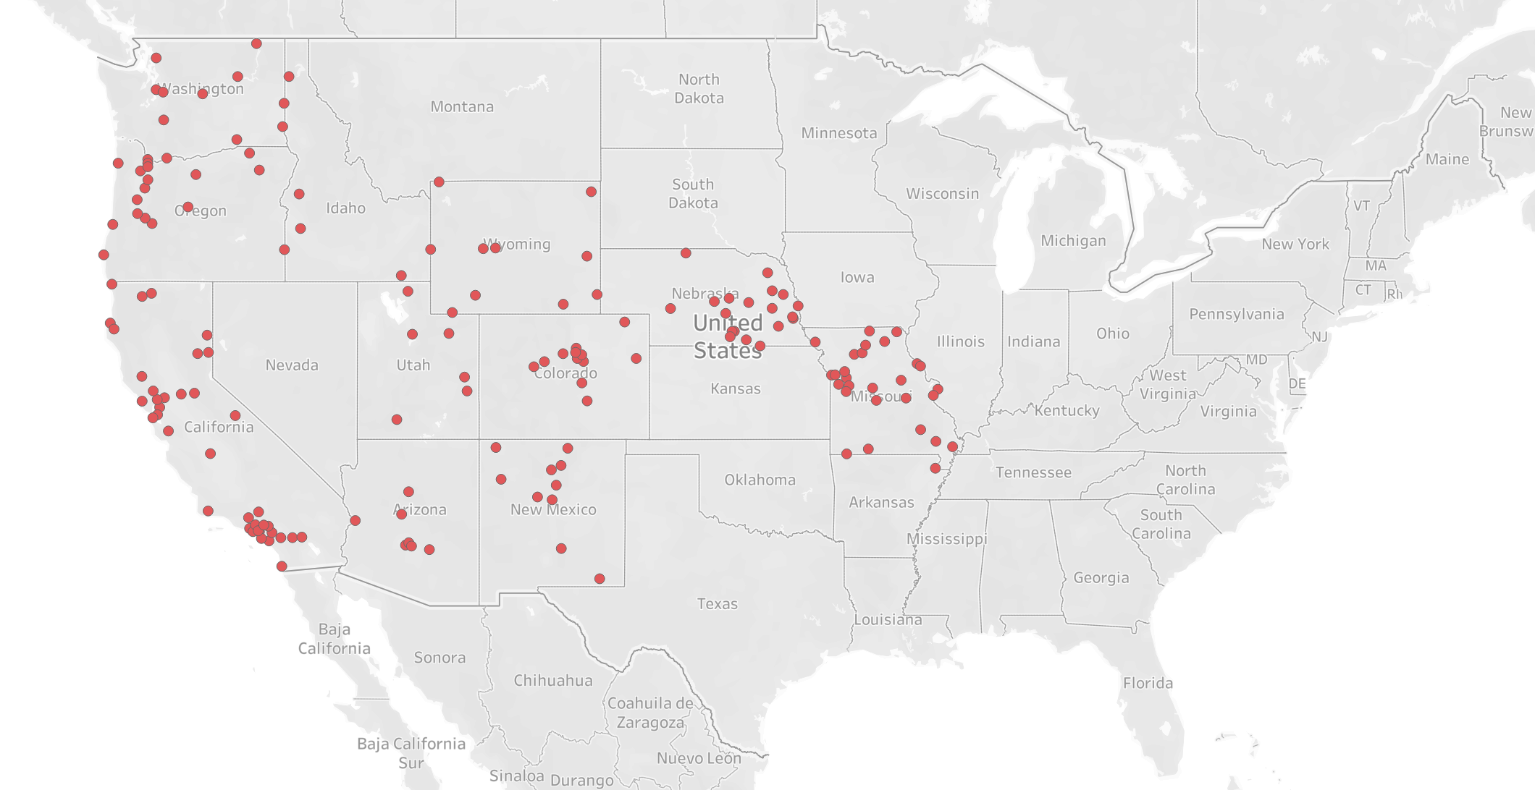

Slide 28

WHICH STATE HAS THE HIGHEST FRAUDULENT TRANSACTION AMOUNT?

Slide 29
